Slide 1
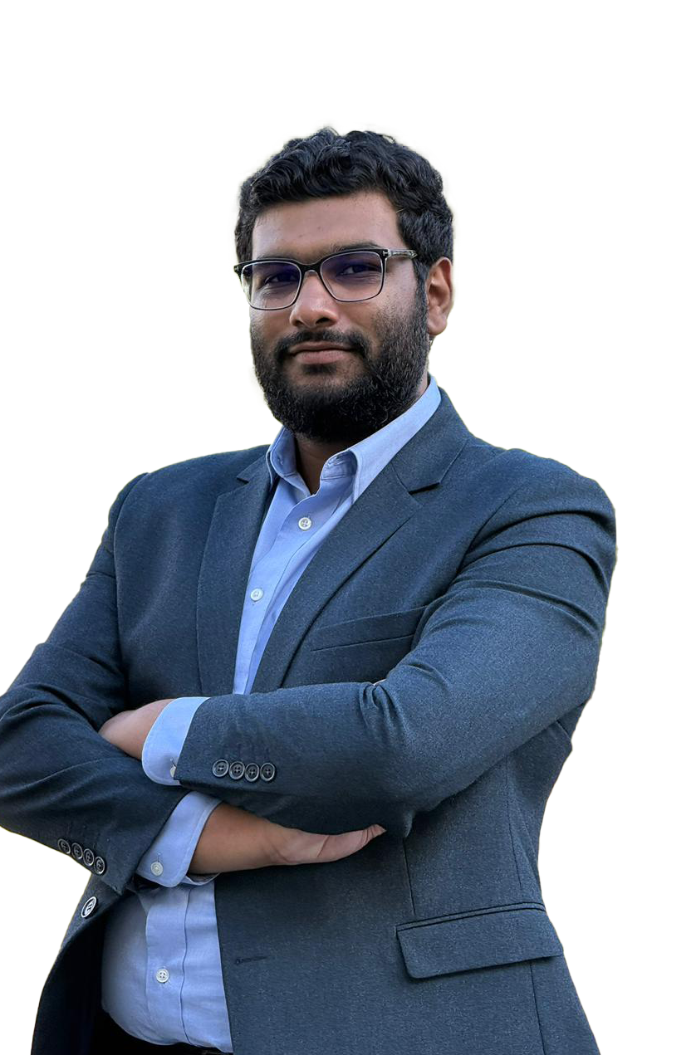



Hello, I am
Farhaan Beeharry
Mobile Developer/Software Engineer
I’m a software engineer with 4 years of experience, passionate about turning ideas into impactful digital solutions.
My inspiration comes from innovation, creativity, and the drive to build tools that make life simpler.
CRAFTING MY PATH
(230) 5707 6881
contact@farhaan.info
https://www.farhaan.info
2025

Slide 2
My Skill
Education & Certifications
University
Academy
CRAFTING MY PATH
September 2021
January 2022
BSc Computer Science (Systems Engineering)
ELCAdemy
Middlesex University, Mauritius
Information Technology ELCA Ltd
Earned a First Class Honours
Built a strong foundation in software and system design
Gained hands-on experience in software development and enterprise systems.
2025

Slide 3
Over the years, I’ve gained hands-on experience building scalable digital products across multiple industries. My focus has always been on delivering solutions that bring real value to users and businesses.
About Me
Work Experience
2021
2023
Present
CRAFTING MY PATH
Aug 2021 – May 2023
Jun 2023 – Sep 2024
Oct 2024 - Present
Information Technology ELCA Ltd
Kurrent (ex EventStore)
DietSensor
Weartwice
XEFI Center Mauritius
Remote, United Kingdom
Ebène, Mauritius
St Pierre, Mauritius
Remote, France
2025
Remote, United Arab Emirates

Slide 4
Awards
Achievement & Rewards
2020
2021
2022
2023
CRAFTING MY PATH
Digicup
UoM - TechWar
Mobile App Design
InovApp 3.0
Second prize winner
Second prize winner
Third prize winner
🏆 First prize winner 🏆
inovapp.mu
2025

Slide 5
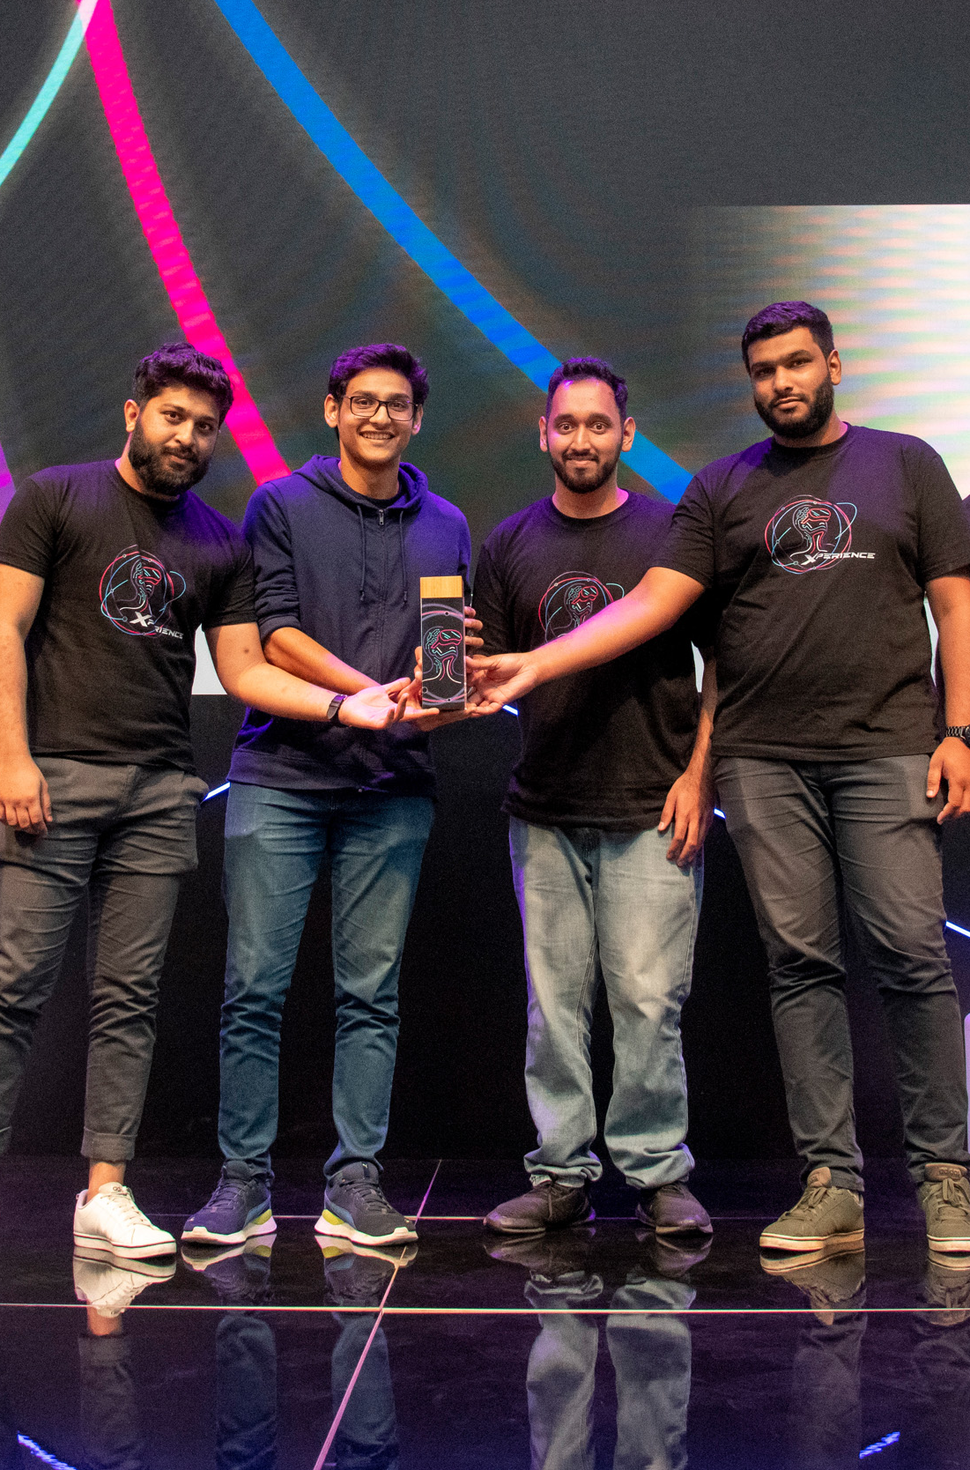
About InovApp Challenge 3.0
Innovate. Create. Transform.
The MCB InovApp Challenge 3.0 is a premier hackathon that brings together talented minds, from students to start-ups, to create next-generation solutions for the banking sector and beyond.
Participants collaborate in teams over an intense 24-hour sprint to design innovative, high-impact digital products.
The event fosters creativity, teamwork, and real-world problem-solving, offering a platform to showcase skills and drive meaningful change.
🏆 First prize winner 🏆
CRAFTING MY PATH
2025

Slide 6
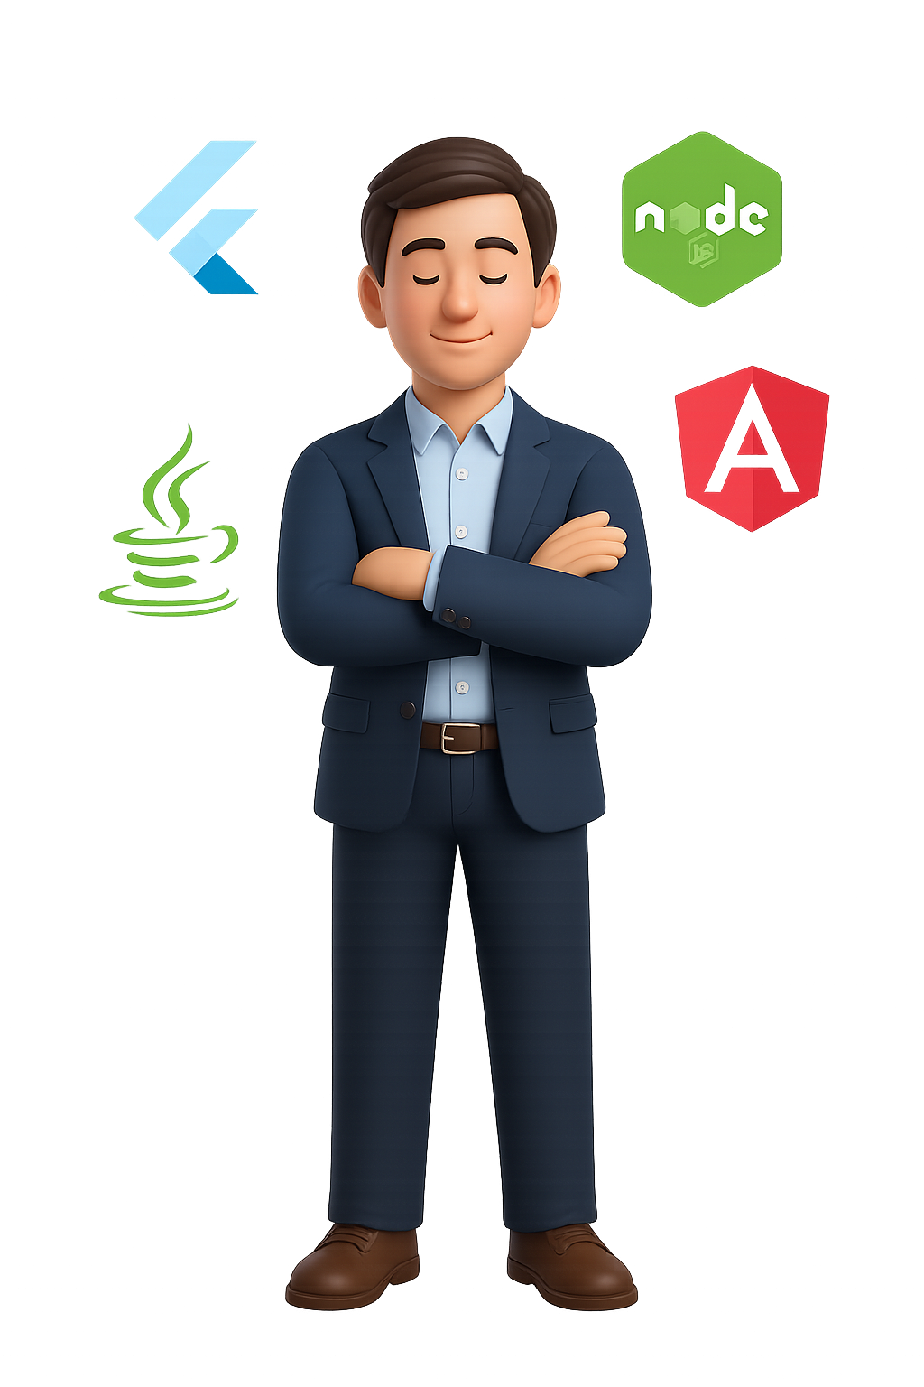




My Skill
Technology Skills
Flutter
85%
NodeJS
CRAFTING MY PATH
80%
Angular
75%
Java (Spring/Spring Boot)
65%
2025

Slide 7
My Skill
Core Competencies
Mobile & Web Development
Technical Leadership
System Architecture
CRAFTING MY PATH
Building scalable, high-performance apps with Flutter and modern techs.
Guiding projects and teams with clarity, collaboration and ownership.
Creating efficient, secure and maintainable system structures.
Problem Solving
Agile Practices
UI/UX Implementation
Transforming challenges into creative, impactful digital solutions.
Delivering quality through agile and result-driven workflows.
Blending design precision with usability for seamless experiences.
2025

Slide 8
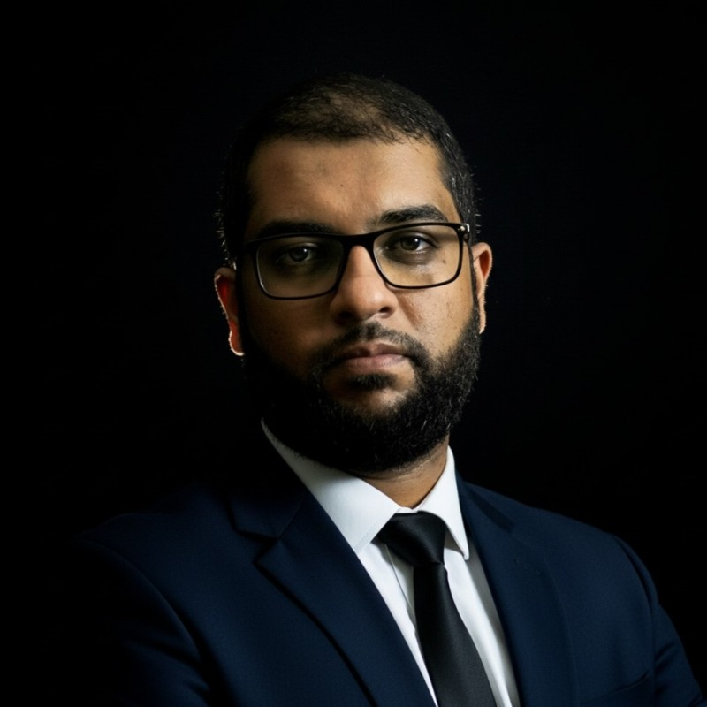
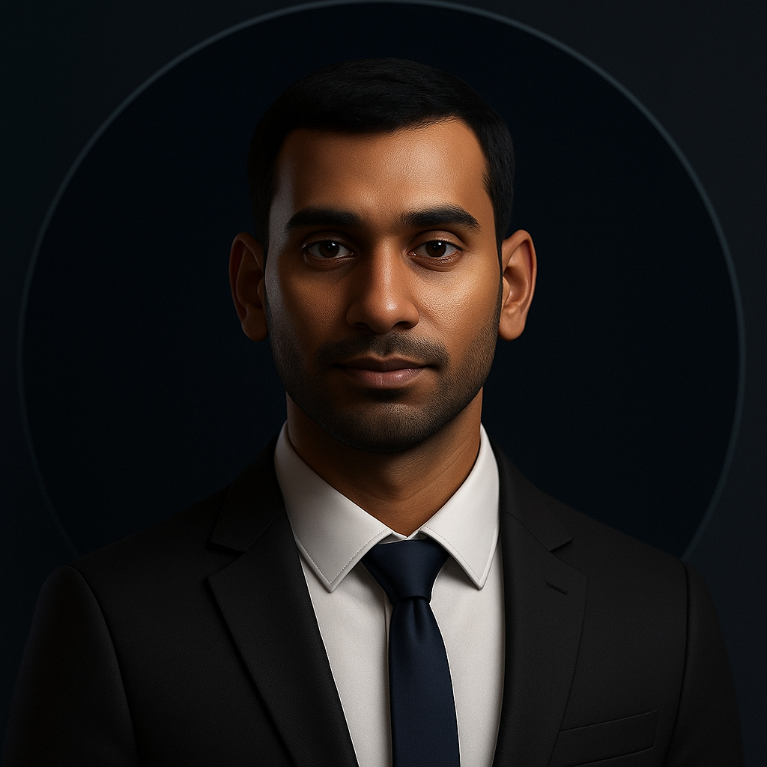
Testimonial
Testimonials / References
“
“
Working with Farhaan Beeharry was a real pleasure. He’s a skilled and dependable Flutter developer who consistently delivers high‑quality work. What stood out most was how easy and pleasant he was to work with. He’s friendly, respectful, and a genuine team player.
I’ve seen Farhaan grow rapidly as a Flutter developer. He’s a quick learner who takes initiative, asks the right questions, and translates feedback into tangible improvements. A great teammate with strong potentials.
CRAFTING MY PATH
Zubair Tofy
Dheeraj Tilhoo
Co-founder & Lead Developer
MetaBox Technologies
Lead Flutter Developer
XEFI Center Mauritius
2025

Slide 9
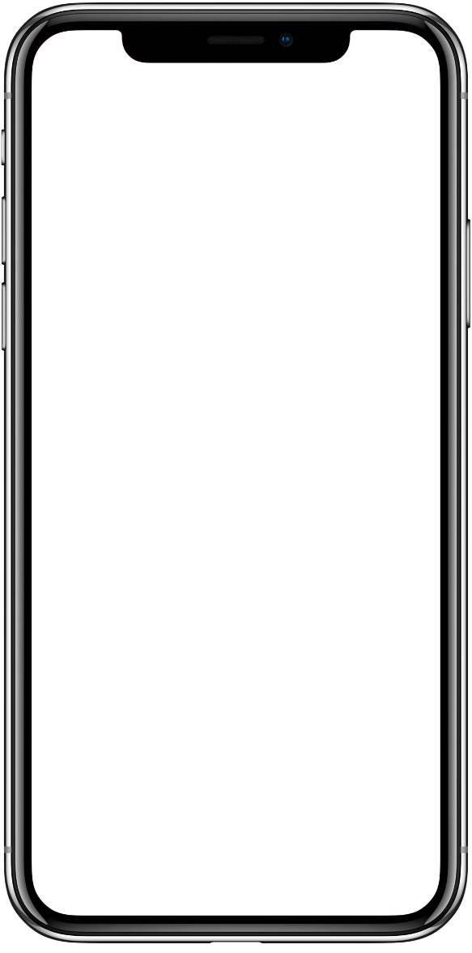
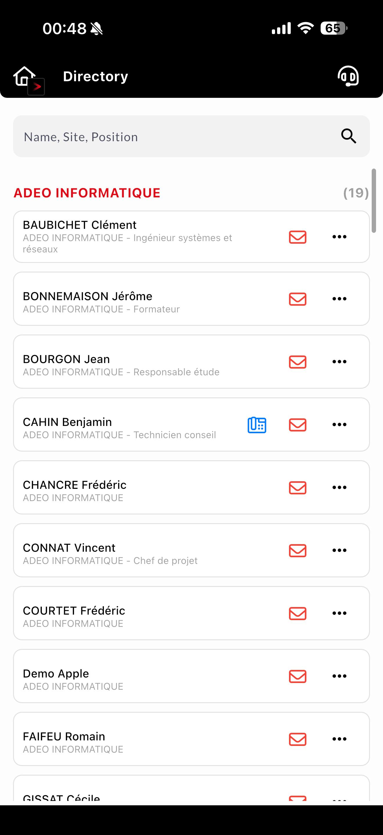
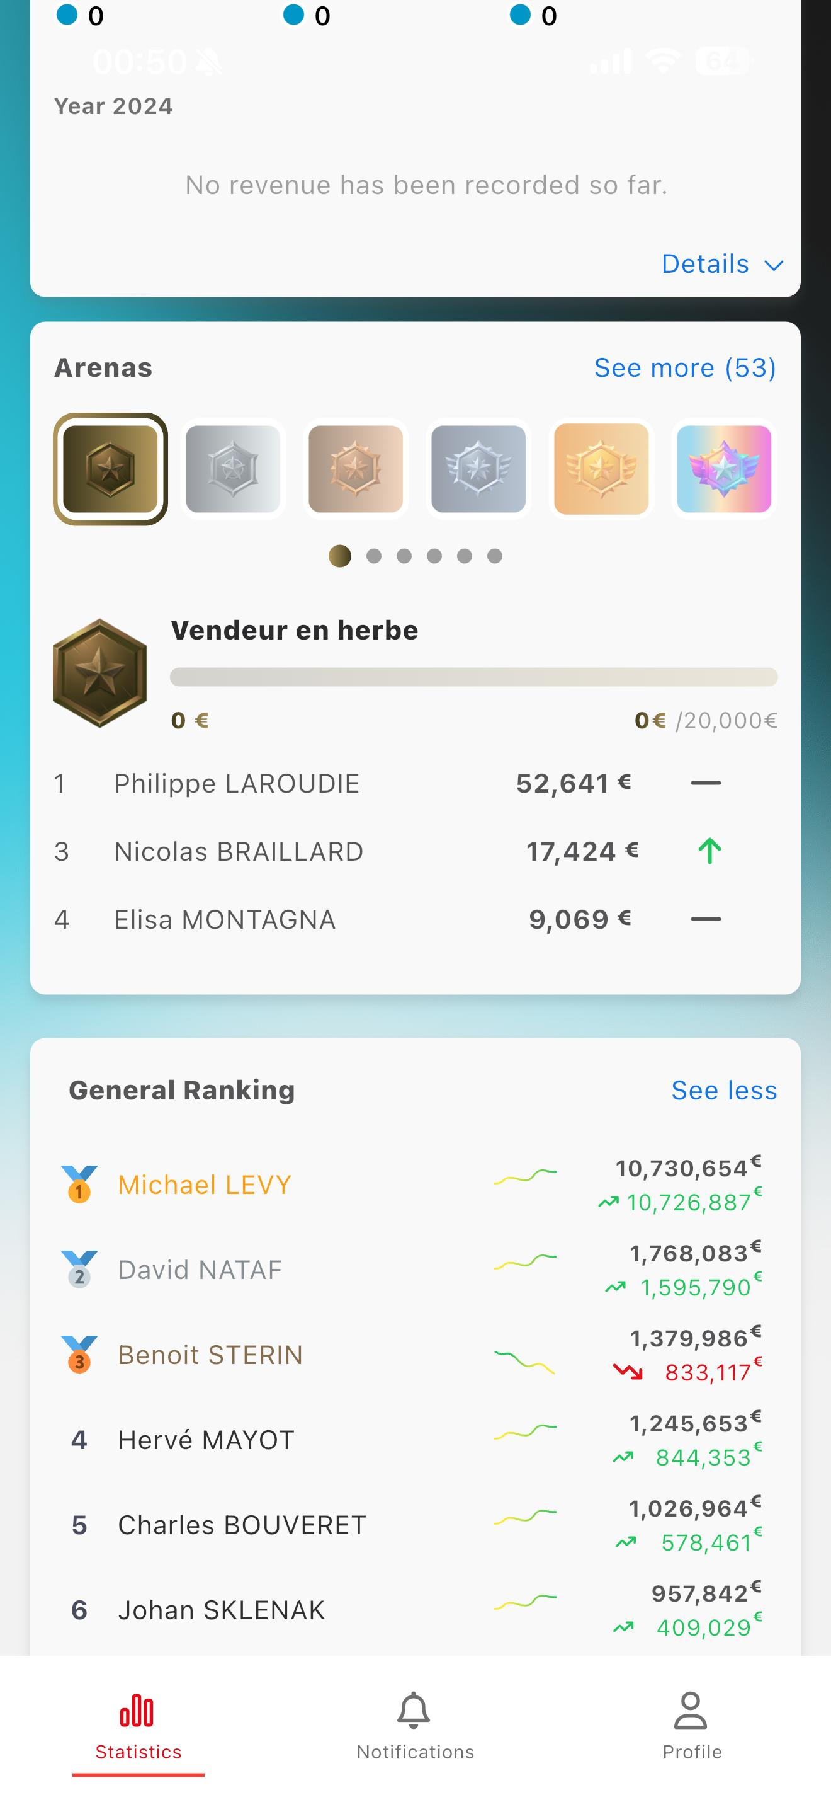
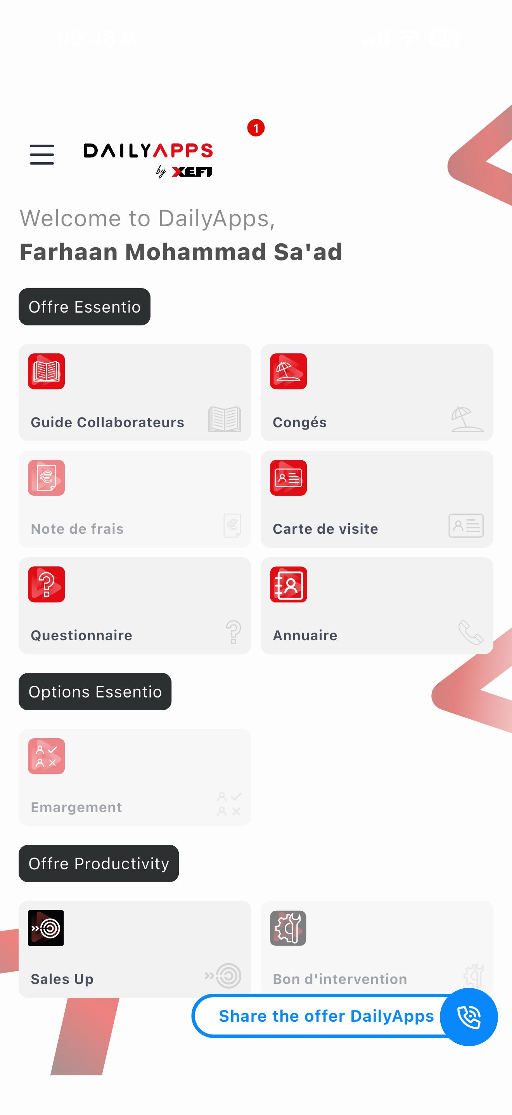
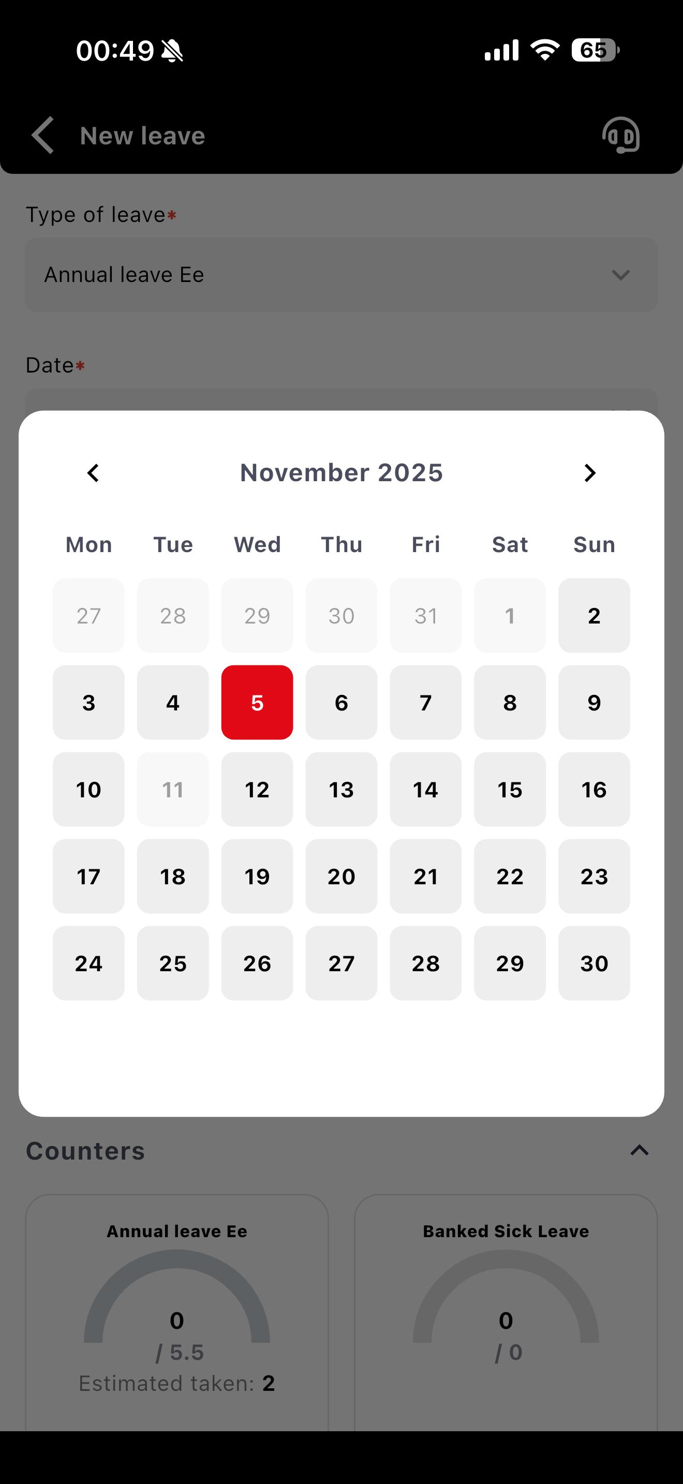
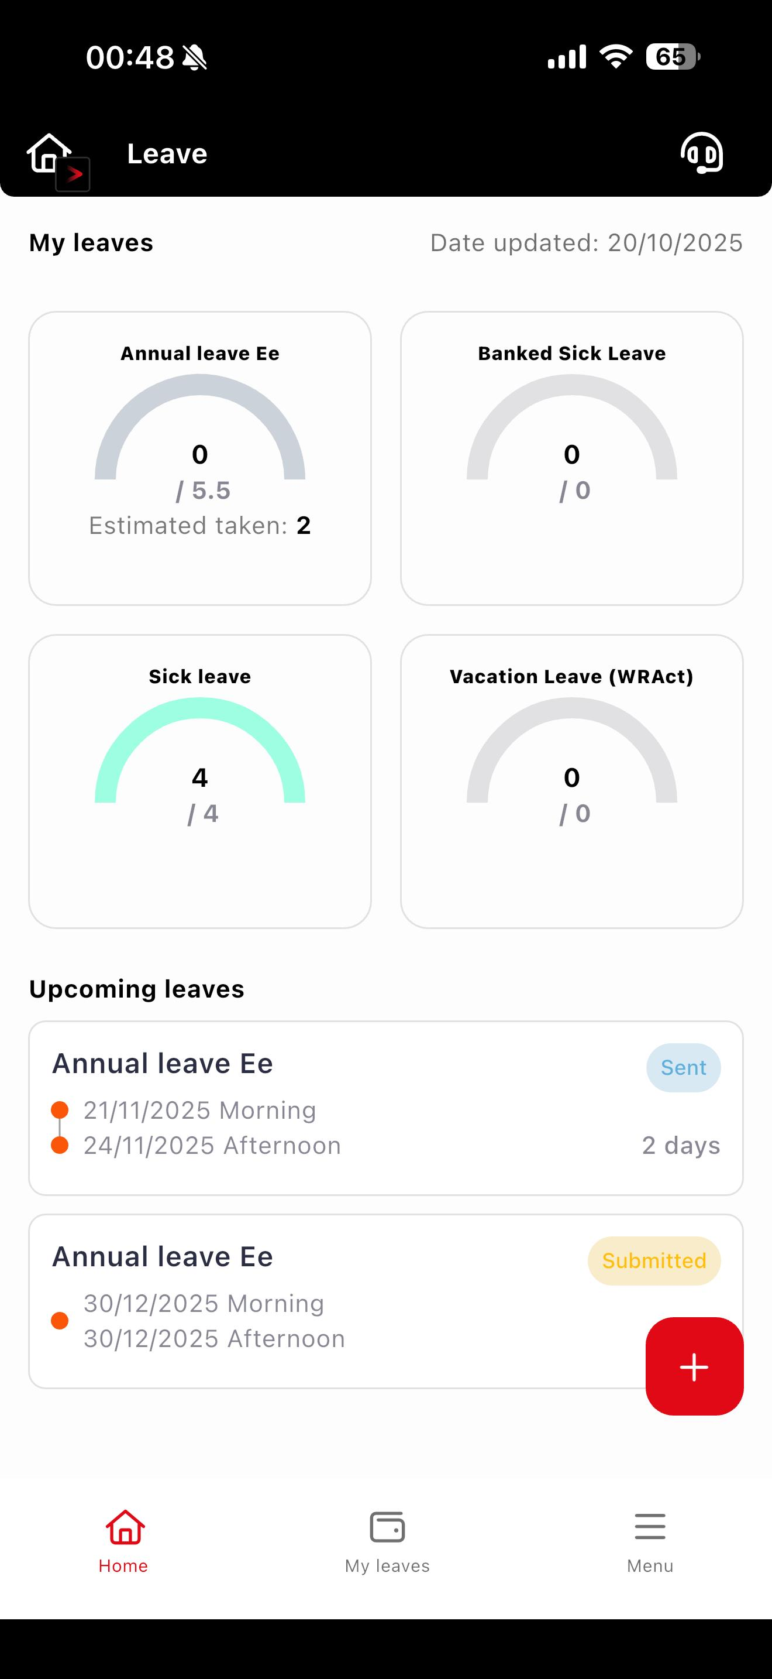
Projects
DailyApps
Key Features:
Developed my own calendar library
From separate apps to multi-modules app
Technology used:
Flutter & Shorebird
All-in-one digital solution for HR and admin management
Centralizes leave requests, expense reports and more…
Boosts productivity through workflow automation
Helps save time, digitalize processes and streamline HR operations
CRAFTING MY PATH
2025

Slide 10
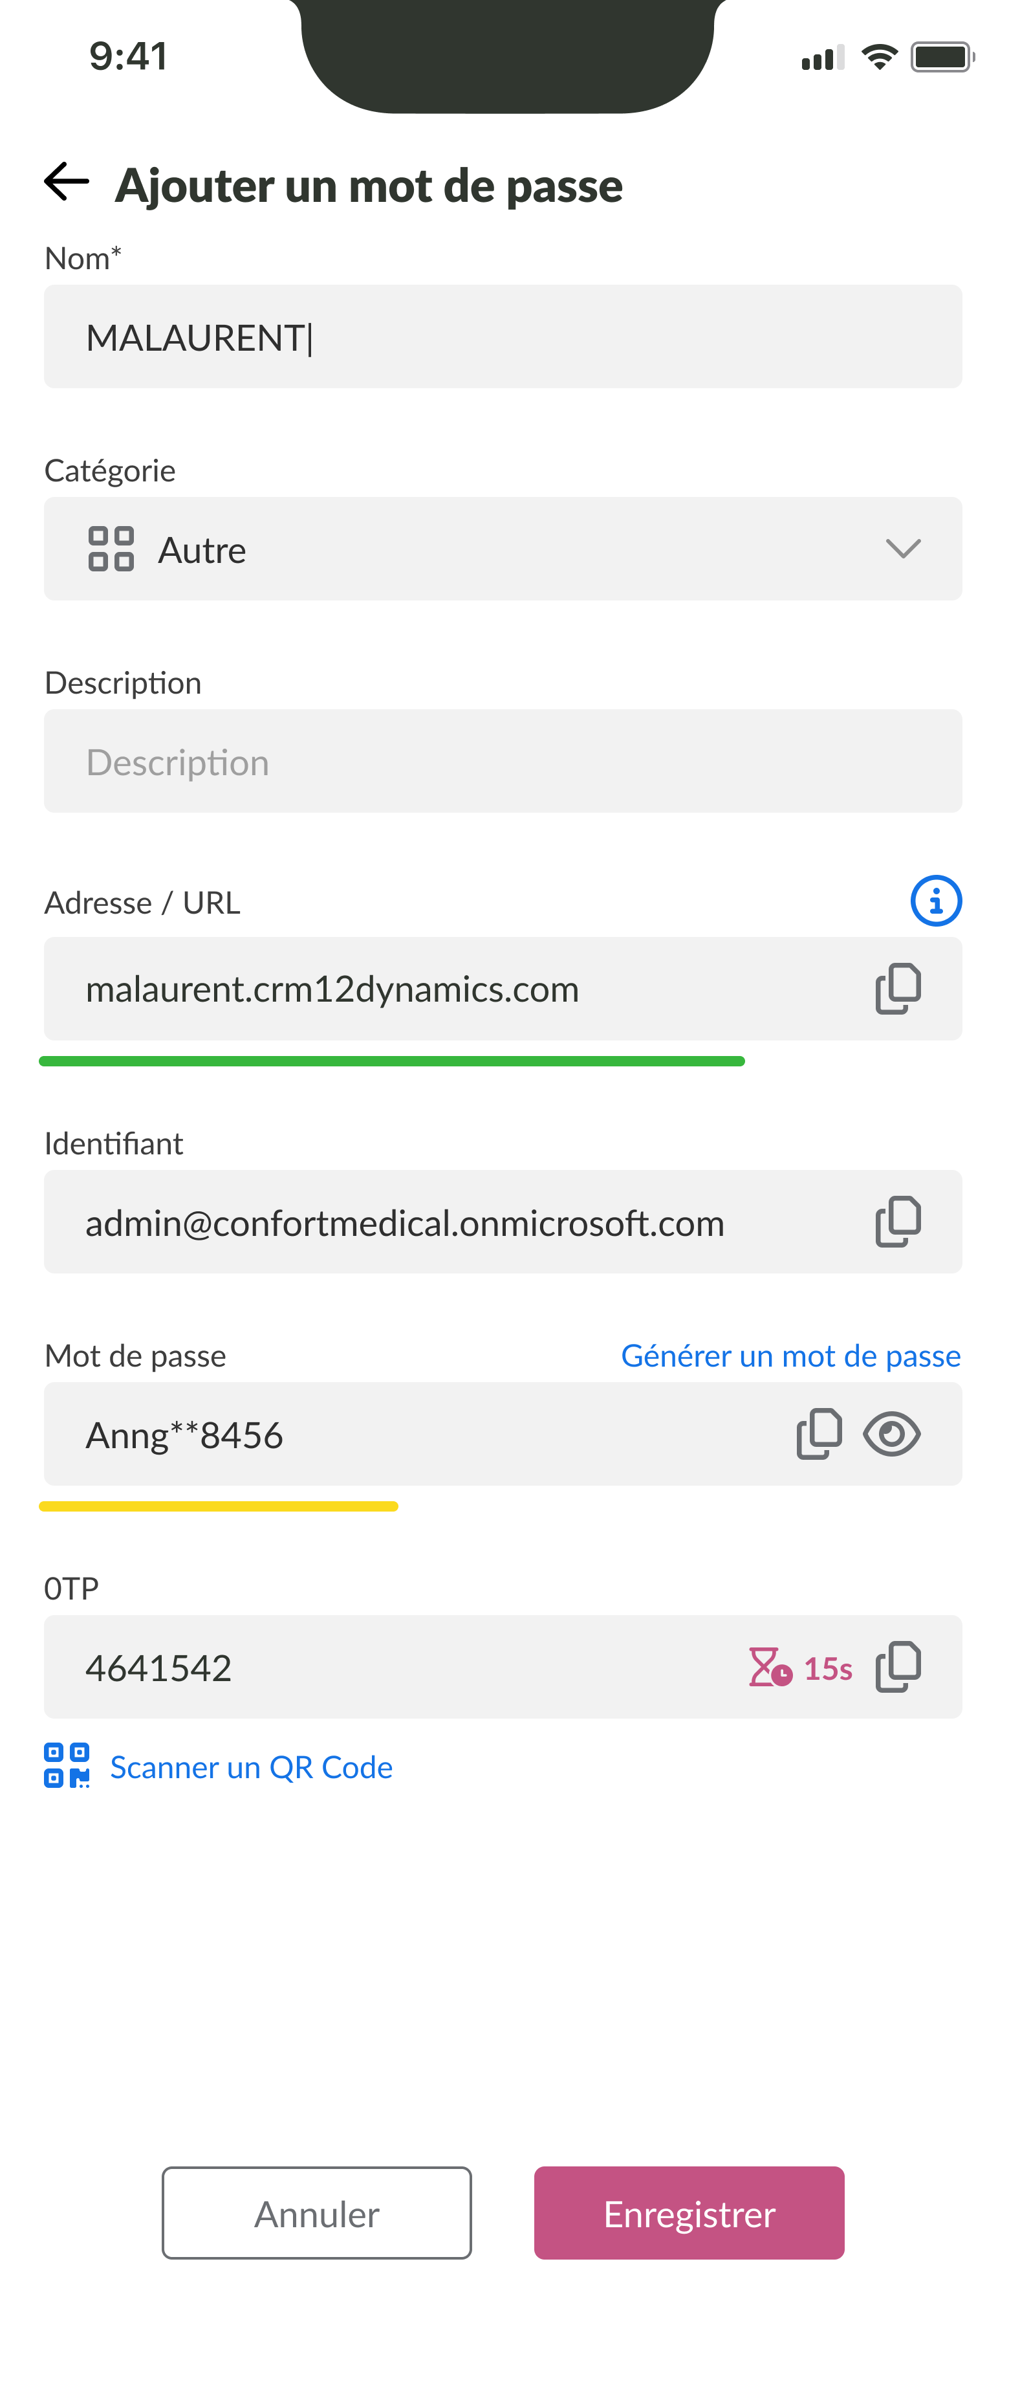
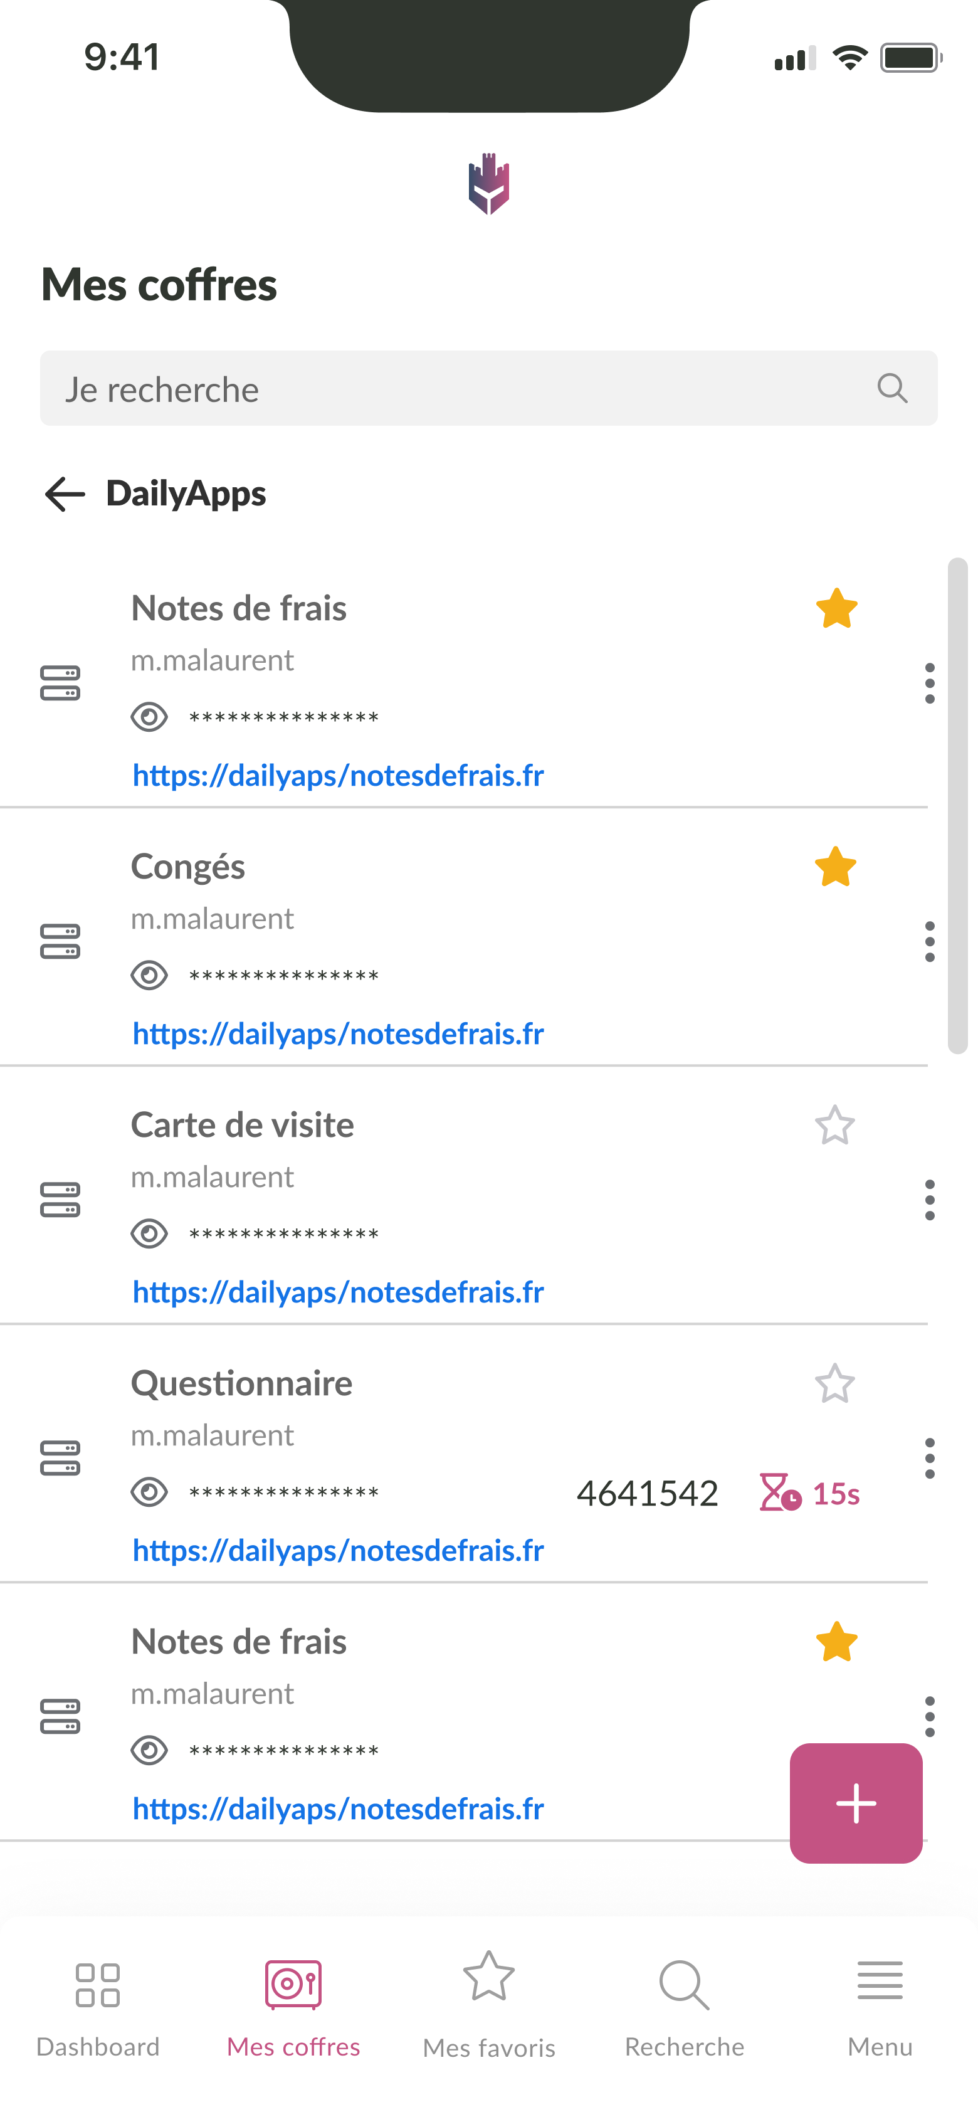
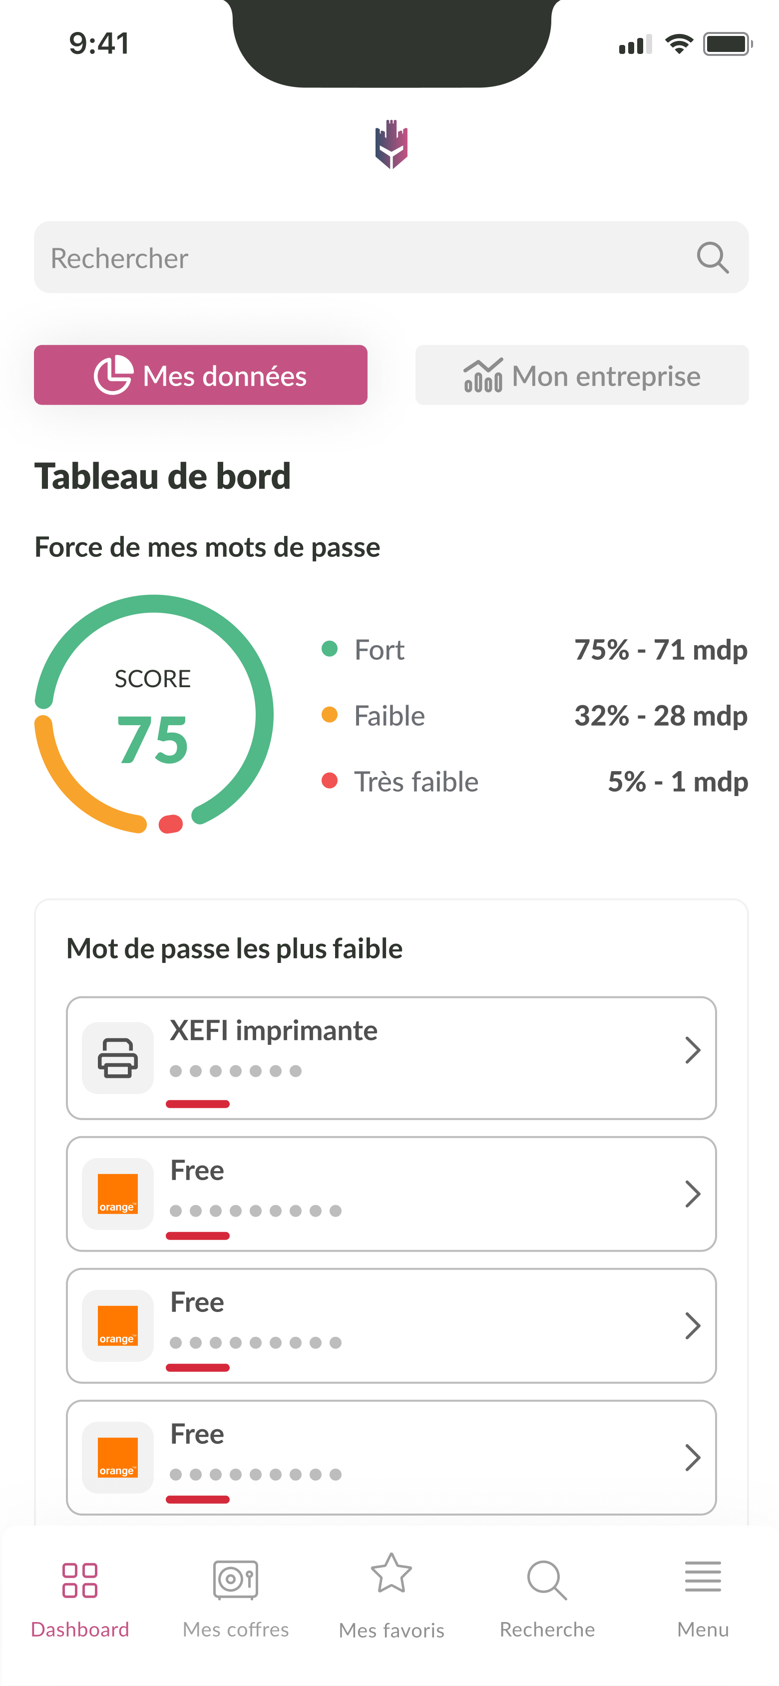
Projects
Kalydian
Secure and professional password manager
Centralized vaults, strong encryption and real-time password monitoring
Individual and shared vaults
Enables auto-fill, password generation and secure sharing via self-destructing links
Key Features:
Native integration with Flutter bridging
Password generation
Technology used:
Flutter
CRAFTING MY PATH
2025

Slide 11
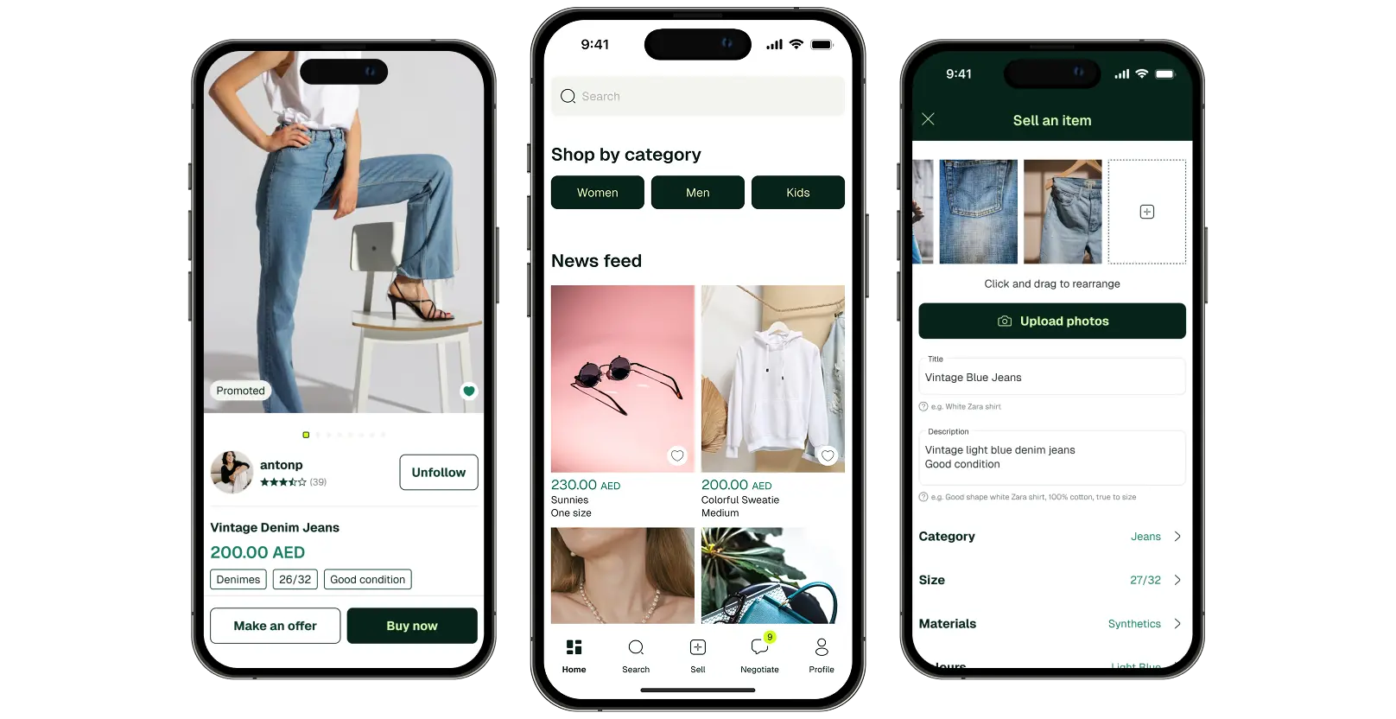
Projects
WearTwice (based in UAE)
Revolutionary mobile app redefining second-hand fashion
Secure payment integration with MamoPay
Real-time chat and offer system
Integration with AJEX delivery system
Key Features:
Live chat and instant notifications
Live delivery updates and tracking
Technology used:
Flutter, MamoPay & AJEX
CRAFTING MY PATH
2025

Slide 12

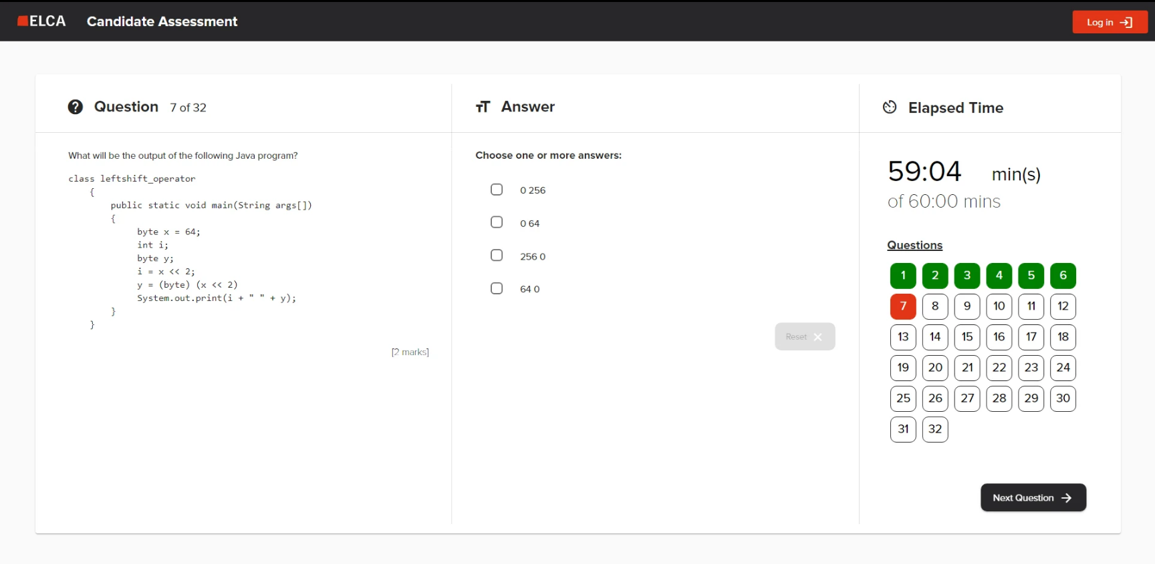
Projects
Candidate Assessment System
Help employers identify most qualified applicants efficiently and accurately
Supports multiple-choice, multiple-answers and open-ended questions
Customizable assessments to suit different job roles or departments
Real-time updates and automatic scoring
Key Features:
Offline ability to continue and synchronization
Anti-cheat system/Candidate monitoring
Technology used:
Angular, Java (Spring & Spring Boot) and PostgreSQL
CRAFTING MY PATH
2025

Slide 13
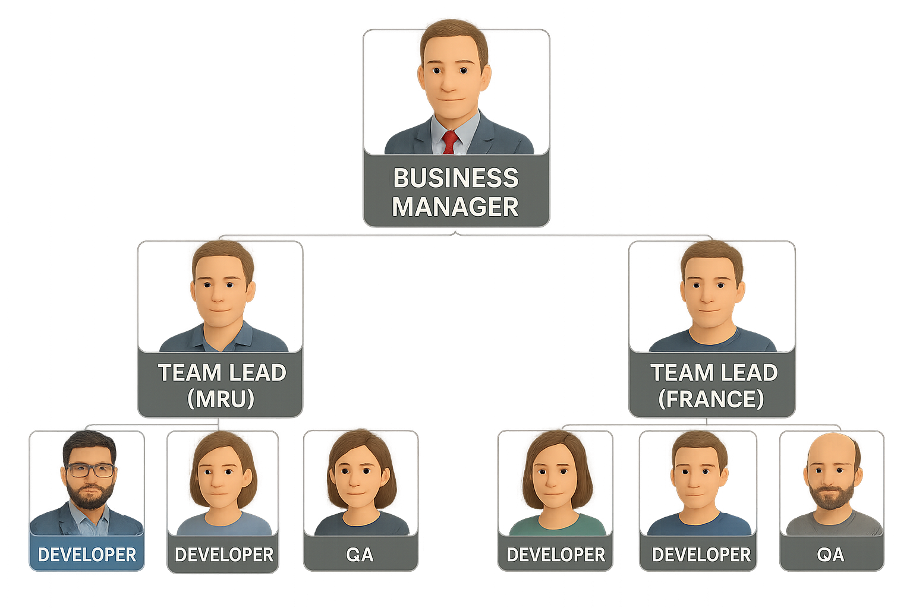
My Experience
Team Structure & My Role
About my Experiences
Part of 2-countries team under a manager
Deliver features within sprint goals
Actively join daily stand-ups and sprint planning ceremonies
Collaborate with developers and QAs
Agile teamwork across two countries; delivering features, collaborating daily and improving through iterative sprints.
CRAFTING MY PATH
Agile Methodology
Iterative development with continuous feedback
Collaboration through regular team ceremonies
Fast delivery via 2 weeks sprints
2025
Me

Slide 14



Project Fit
Why Am I Interested in Amadeus?
CRAFTING MY PATH
Perfect Alignment
Technical Expertise
UX Focus
My experience in secure and high-performance Flutter apps matches Amadeus’s project needs
Proven skills in Flutter, native integrations and scalable modular architecture
Skilled at crafting intuitive, reliable and high-performance apps that scale globally
2025

Slide 15

Thank You
For Your Attention
CRAFTING MY PATH
(230) 5707 6881
contact@farhaan.info
https://www.farhaan.info
2025

